Slide 1








Miraze
AI - VANCE
A future where traffic signals think, act, and save lives is no longer a dream—it’s a necessity
By- Asutosh Nayak

Slide 2
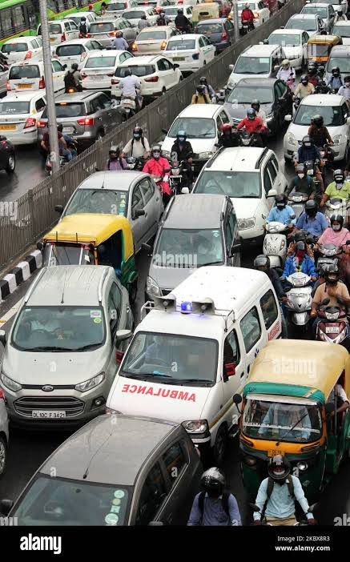
Problem Statement:-
Every day, ambulances get stuck in heavy traffic, delaying critical patients from reaching hospitals on time. Despite flashing lights and loud sirens, traffic congestion prevents smooth movement, leading to life-threatening delays.
KEY ISSUES:-
Traffic lights do not prioritize ambulances – They operate on fixed timers and do not respond to emergencies.
Severe congestion blocks ambulances – Even when other drivers try to make way, packed roads leave no space to move.
No system to prioritize high-risk cases – All ambulances are treated the same, even when some carry critical patients. As a result, precious minutes are lost, and in many cases, so are lives.
What if traffic signals could detect ambulances and instantly clear the way?
This is where our AI-VANCE comes in—an AI-powered solution
to automate traffic signals, detect ambulance urgency, and save lives.
Link of the prototype video of our project
https://drive.google.com/file/d/1ao-HJmy99buSYrjx86SF1TFvUp8eEs4P/view?usp=sharing

Slide 3



proposed solution:-
AI-Powered Camera Detection:-
Here we will use pre-installed cameras which are installed near traffic signals that are used for the purpose of surveillance and challan-cutting.
CCTV cameras upgraded with AI will detect ambulances 300m away.
The system will automatically turn the ambulance’s lane green and others red.
Once the ambulance crosses the intersection, signals will return to normal.
WHY THIS WORKS:-
Real-time traffic signal adjustments for faster emergency response.
Automatic prioritization of critical cases to save more lives.
Works with existing infrastructure, making it cost-effective & scalable.

Slide 4


working of AI CAMERA :-
The AI-powered camera system detects ambulances in real-time and automatically controls traffic signals to clear the way. It follows a First-Come, First-Priority Algorithm to ensure smooth movement.
Step-by-Step Process:
Ambulance Cross the traffic
Ambulance Appear
Traffic Signal Turns Green
FCFS(first come first serve) algorithm
Under 300m range of AI Camera
Traffic signal come back to it’s Original signal
Ambulance Detection

Slide 5

Risk challenges faced:-
challenges:-
Conflicting Ambulance Priorities
Two ambulances approach an intersection:
1️⃣ Closer ambulance but no patient.
2️⃣ Farther ambulance with a critical patient.
If priority is based only on distance, the wrong ambulance may get the green signal first.
solutions:-
Ambulance sirens are classified into three risk levels:
🔴 High Risk – Critical emergency (priority lane turns green).
🟠 Moderate Risk – Urgent but stable case.
🟢 Low Risk – Non-emergency transport.
AI-powered microphones detect siren levels, ensuring high-risk ambulances get priority, even if farther away.

Slide 6

The Sound-Based Tracking & Priority System:-
The sound-based tracking system uses AI-powered microphones to classify ambulance sirens based on urgency. It follows a High-Risk First Priority Algorithm, ensuring the most critical ambulances get a clear path first.
Step-by-Step Process:-
1.Microphone Detection
AI-enhanced microphones are installed at traffic intersections.
The system analyzes sirens in real-time to determine urgency.
3.Traffic Signal Adjustment
The priority ambulance’s lane turns green, while others stay red.
Once it crosses the intersection, the system checks for other ambulances and repeats the process.
2.Risk-Based Priority Assignment
AI categorizes sirens into three risk levels:
High Risk: Life-threatening emergencies (e.g., cardiac arrest).
Moderate Risk: Urgent but stable cases.
Low Risk: Non-critical patient transport.
High Risk >> Moderate Risk >> Low Risk
The highest priority ambulance (High Risk) gets the green light first.

Slide 7
FEASIBILITY:-
Technical Feasibility
Financial Feasibility
Operational Feasibility
Societal Feasibility
Uses existing CCTV cameras & traffic signals – Requires only an AI software upgrade.
AI-based computer vision (YOLO, OpenCV) for ambulance detection.
Microphone-based siren classification for risk-based prioritization.
Cloud-based or edge computing for real-time decision-making
Cost-effective – No need for new traffic light installations, just software and hardware upgrades.
Low maintenance cost – AI models can be updated remotely.
Scalable for smart city expansion with minimal investment.
Seamless integration with traffic management systems.
Fully automated system reduces human intervention and errors.
Works in all weather conditions with infrared/night-vision camera support.
Saves lives by reducing emergency response time.
Reduces congestion and improves traffic flow.
Enhances public trust in smart city solutions.

Slide 8
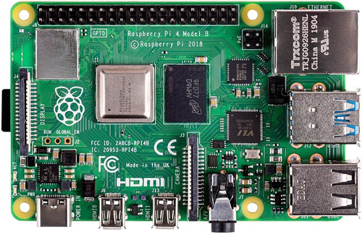



technology stack and implementation:-
hardware components:-
AI Camera – Uses TensorFlow Lite & Teachable Machines for real-time ambulance detection.
Raspberry Pi 4B – Edge computing device for processing AI models.
Traffic Lighting Modules – Controls traffic signals dynamically.
Microphone & Audio Sensing – Detects ambulance sirens for priority classification.
5V Buzzer – Provides alerts based on AI decisions.
software & ai implementation:-
TensorFlow Lite – Optimized AI model for ambulance detection on edge devices.
Python, NumPy – Core programming for AI processing.
Py Audio & Py Serial – Handles audio input and signal processing.

Slide 9
Future Implementation :-
Objective:
Develop an AI-powered system to detect road accidents in real-time.
Process
- Detect accidents using AI-powered image/video analysis.
-Instantly notify the nearest hospital and emergency services.
- Share real-time location data for faster response.
Impact:
- Reduces emergency response time.
- Increases survival chances for accident victims.
- Enhances smart city infrastructure.
After succeding in this project

Slide 10
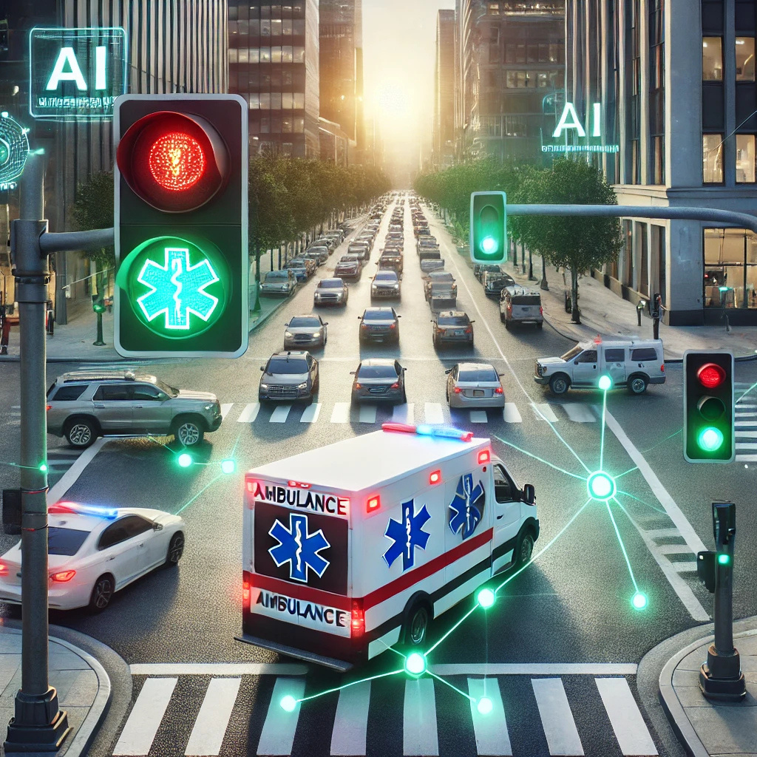
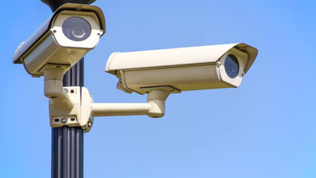
conclusion:-
The AI-VANCE is a game-changer in traffic management, ensuring ambulances reach hospitals without unnecessary delays. By integrating AI-powered cameras and sound-based tracking, our system automates traffic signals, prioritizes critical cases, and reduces emergency response time.
Why This Matters:
Saves lives by clearing traffic for critical patients.
Uses AI and existing infrastructure for a cost-effective solution.
Ensures real-time decision-making with automated traffic signals.
Scalable for smart cities, making urban mobility safer and smarter.
A future where traffic signals think, act, and save lives is no longer a dream—it’s a necessity

